Slide 1

RST API 2011.8.4
叶雄进 Joe Ye
DevTech China Supervisor

Slide 2
预备知识
Revit API 基础
在ADN网站和Autodesk 网站有我所做过的培训录像
Revit 2011 API DevTV
Revit API – 2011 & 2012 新功能
Revit 2011 API （中文）
Revit 2012 新 API的用法
教室培训

Slide 3
Agenda
RST API功能
RST基础知识
荷载和荷载工况
结构构件
结构分析模型
钢筋与配筋
Revit 平台API在Revit 结构中的应用
可视化分析显示
动态模型更新
Idling 事件
Revit Structure (RST) 2012 API 新功能

Slide 4
RST API 功能
Structure对象的创建，读取，编辑
结构构件信息
荷载（点线面），荷载组合和工况
构件约束
分析模型线信息
构件之间的支撑关系（只读）
钢筋形状、钢筋

Slide 5
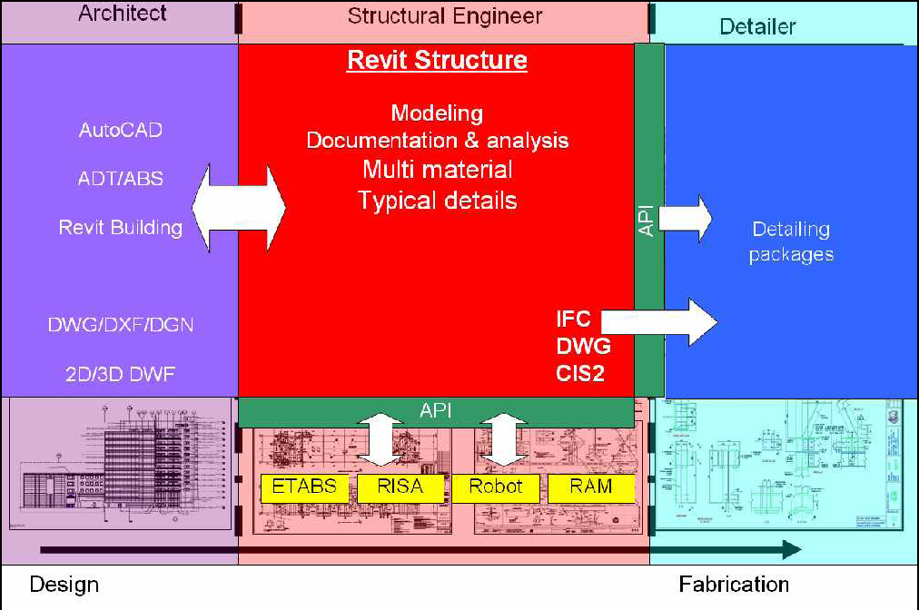
工作流
Notes:
Revit Structure is used by a structural engineer to manage and combine data from several different sources:
Architectural data, the building design, which can come from Revit Architecture, but also from other Autodesk or non-Autodesk products.
Analysis data for stress analysis in external packages.
Details which are designed based on the analysis results.

Slide 6
基础知识：Loads and Load Cases

Slide 7
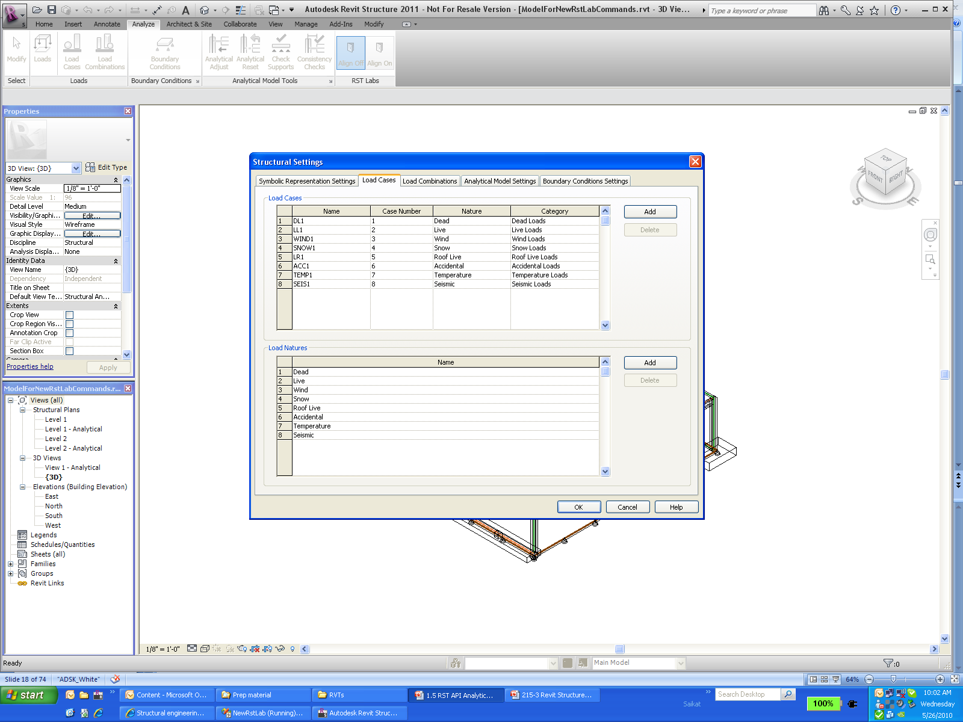
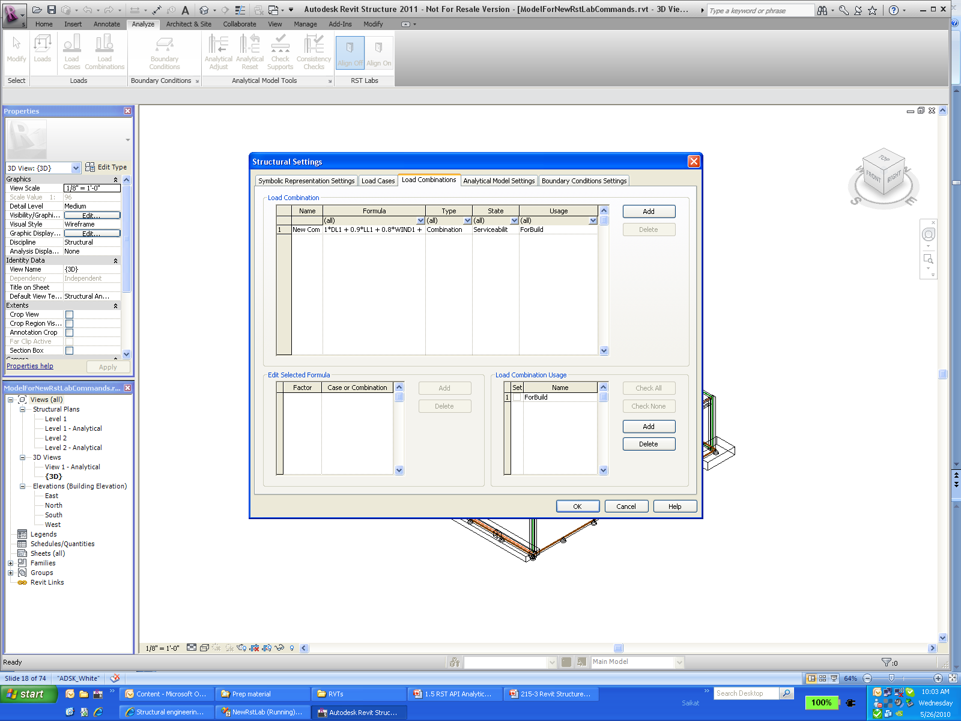
荷载相关对象 Overview
Load Cases
Load Natures
Load Combinations
Load Usages
Notes:
Load Nature: Refers to Dead, Live, Snow, Roof, Accidental, Temperature etc
Load Cases: refers to forces caused by different nature and category (for example load caused by wind : nature is wind and category is wind loads). A load case is a set of loads that make up a specific set of loading such as Self Weight (Dead Load).
Load Combination : refers to combining several different load cases, all of which work together on a building. For example: during earthquake, typical load combination would include self gravity + dead load + seismic load + live load.
The load combination usage parameter is user defined (either gravity, lateral or combined).
Gravity Load Combinations include the vertical loads, both permanent or dead (self weight of the structure - floor, beams, columns etc.) and live loads based on occupancy (people on an office floor, boxes in a storage room, snow on a roof, etc.).
Lateral Load Combinations include the horizontal loads, both permanent or dead (soil resting up against a foundation wall) and live loads (wind against the face of a structure or the shaking of a structure from an earthquake).
Combined Load Combinations include varying degrees of both gravity and lateral loads in order to account for cases when structures are both occupied and experiencing wind or earthquake loads.
All the functionality in the Settings dialog box of Load cases and Load Combinations tabs can be accessed using the API.

Slide 8
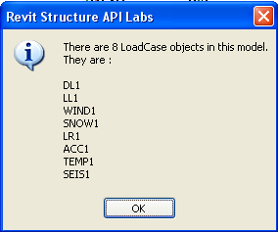
Lab – 荷载工况Load Case
访问 LoadCase 对象
Transaction trans = new Transaction( doc, "Lab1_1" );
trans.Start();
//List LoadCase in current model
IList<Element> lists = RstUtils.GetElementOfClass(doc, typeof( LoadCase ) );
string sMsg = null;
sMsg = string.Format( "There are {0} LoadCase objects in this model.\n They are :\n",
lists.Count );
foreach( Element elem in lists )
{
LoadCase ln = elem as LoadCase;
sMsg += ln.Name + "\n";
}
RstUtils.InfoMsg( sMsg );

Slide 9
Lab – 荷载用途 Load Usage
创建 LoadUsage 对象
string sName = "MainTainLoad";
Boolean bExist = false;
IList<Element> listLU = RstUtils.GetElementOfClass(
doc, typeof( LoadUsage ) );
foreach( Element elem in listLU )
{
if( elem.Name.Equals( sName ) )
{
bExist = true;
break;
}
}
if( !bExist ) { LoadUsage lu = doc.Create.NewLoadUsage( "MaintainLoad" ); }
else
{
sMsg = "LoadUsage MainTainLoad existed. ";
}
RstUtils.InfoMsg( sMsg );

Slide 10
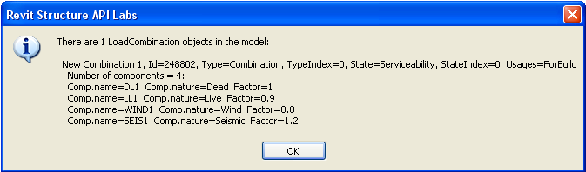
Lab – 访问荷载组合 Load Combination
foreach( LoadCombination comb in listLC )
{
lc1 = comb;
// combinaton properties
string usageNames = ( 0 == comb.NumberOfUsages ) ? "[NONE]“ : comb.get_UsageName( 0 );
for( int i = 1; i < comb.NumberOfUsages; ++i )
{
usageNames += comb.get_UsageName( i );
}
sMsg += "\r\n\r\n " + comb.Name + ", Id=" + comb.Id.IntegerValue.ToString() + ", Type=" + comb.CombinationType + ", TypeIndex=" + comb.CombinationTypeIndex + ", State=" + comb.CombinationState + ", StateIndex=" + comb.CombinationStateIndex + ", Usages=" + usageNames;
sMsg += "\r\n Number of components = " + comb.NumberOfComponents + ":";
// loop all component properties
for( int i = 0; i < comb.NumberOfComponents; ++i )
{
sMsg += "\r\n Comp.name=" + comb.get_CombinationCaseName( i ) + " Comp.nature=" + comb.get_CombinationNatureName( i ) + " Factor=" + comb.get_Factor( i );
}
}

Slide 11
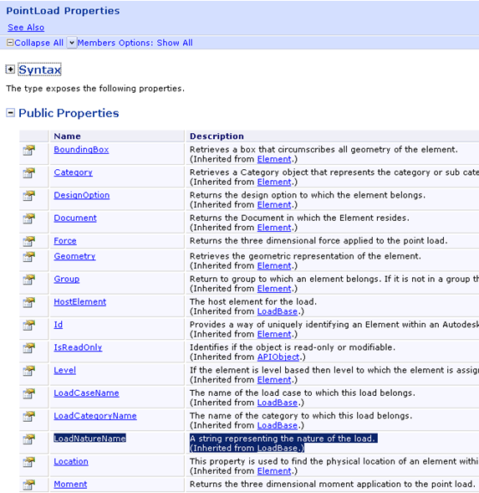
点荷载（Point Load)属性
LoadBase
HostElement
LoadCaseName
LoadCategoryName
LoadNatureName
AreaLoad
LineLoad
PointLoad
Force
Moment
Point
Explore
Help file
Debugger
RevitLookUp(RvtMgdDbg)
Reflection
Notes:
Some of the values accessible through parameters are also exposed directly as properties on the object class.
Whenever you are looking for a specific property, you will need to explore the Revit API and one or more suitable sample models to determine what exactly you are looking for and how to access it.

Slide 12
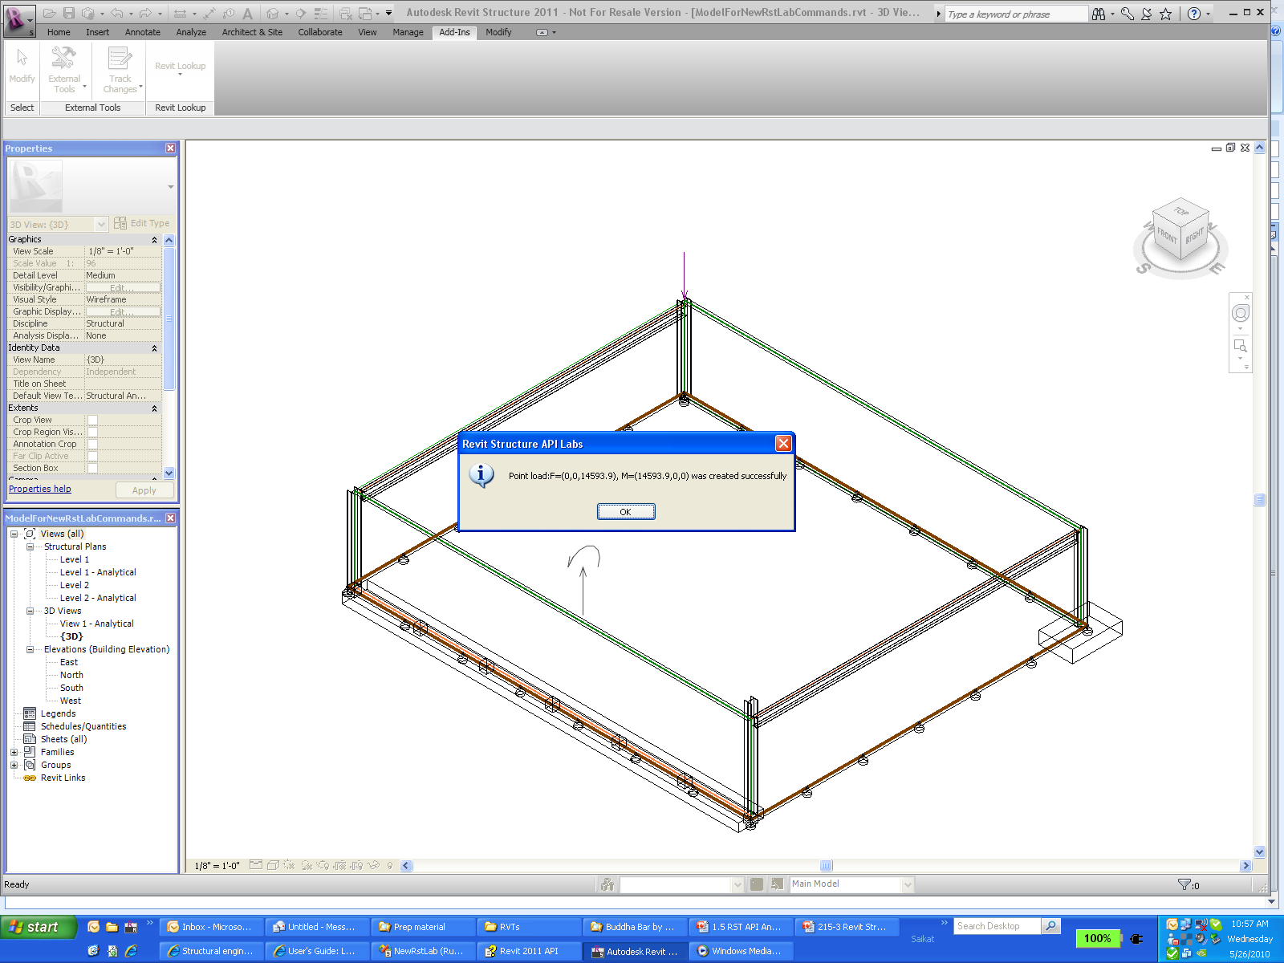
Lab – 创建，访问和修改点荷载
创建点荷载，包含力和力矩
//List Point load types, get the first load type for later usage.
FilteredElementCollector collector = new FilteredElementCollector( doc );
collector.OfClass( typeof( PointLoadType ) );
PointLoadType loadType = collector.FirstElement() as PointLoadType;
//create a point load using the PointLoadType obtained previously
XYZ xyzPt = uiApp.ActiveUIDocument.Selection.PickPoint("Please pick a point to create a point load" );
XYZ xyzForce = new XYZ( 0, 0, dKip );
XYZ xyzMoment = new XYZ( dKip, 0, 0 );
PointLoad plNew = doc.Create.NewPointLoad(xyzPt, xyzForce, xyzMoment, true, loadType, null );
doc.Regenerate();

Slide 13
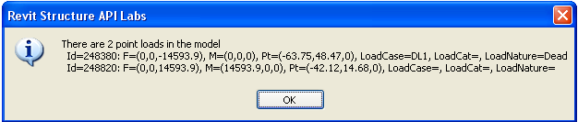
Lab –创建，访问和修改点荷载
列举所有点荷载，同样方法可获得线荷载，面荷载
IList<Element> listLoads = RstUtils.GetElementOfClass(doc, typeof(PointLoad));
PointLoad ptLoad1 = null;
foreach( PointLoad ptLd in listLoads )
{
// The following are all specific READ-ONLY properties:
XYZ F = ptLd.Force;
XYZ M = ptLd.Moment;
XYZ p = ptLd.Point;
string nameLoadCase = ptLd.LoadCaseName;
string nameLoadCategory = ptLd.LoadCategoryName;
string nameLoadNature = ptLd.LoadNatureName;
sMsg += "\r\n Id=" + ptLd.Id.IntegerValue.ToString()
+ ": F=" + RstUtils.PointString( F )
+ ", M=" + RstUtils.PointString( M )
+ ", Pt=" + RstUtils.PointString( p )
+ ", LoadCase=" + nameLoadCase
+ ", LoadCat=" + nameLoadCategory
+ ", LoadNature=" + nameLoadNature;
}

Slide 14
Lab –创建，访问和修改点荷载
修改力的值
Parameter paramFx = ptLoad1.get_Parameter( BuiltInParameter.LOAD_FORCE_FX );
Parameter paramFy = ptLoad1.get_Parameter( BuiltInParameter.LOAD_FORCE_FY );
Parameter paramFz = ptLoad1.get_Parameter( BuiltInParameter.LOAD_FORCE_FZ );
double dFx = paramFx.AsDouble();
double dFy = paramFy.AsDouble();
double dfz = paramFz.AsDouble();
paramFx.Set( dKip );
paramFy.Set( 2 * dKip );
paramFz.Set( 3 * dKip );
doc.Regenerate();

Slide 15
结构构件访问

Slide 16
结构相关对象的类名和类别一览表
Element |  |  |  | Symbol
Kind of Element in UI | Derived from Element/TypeOf | 类别/Category |  | Derived from Symbol/TypeOf | Category
Loads (point load) | LoadBase/PointLoad | Point Loads |  | LoadTypeBase/PointLoadType | Structural Loads
Loads (line load) | LoadBase/LineLoad | Line Loads |  | LoadTypeBase/LineLoadType | Structural Loads
Loads (area load) | LoadBase/AreaLoad | Area Loads |  | LoadTypeBase/AreaLoadType | Structural Loads
Bounding Conditions | BoundaryConditions | Boundary Conditions |  | < null > | ---
Structural Column | Instance/InsertableInstace/FamilyInstance | Structural Columns |  | InsertableObject /FamilySymbol | Structural Columns
Structural Wall | HostObject/Wall | Walls |  | HostObjAttributes/WallType | Walls
Beam | Instance/InsertableInstace/FamilyInstance | Structural Framing |  | InsertableObject /FamilySymbol | Structural Framing
Brace | Instance/InsertableInstace/FamilyInstance | Structural Framing |  | InsertableObject /FamilySymbol | Structural Framing
Component (Column) | Instance/InsertableInstace/FamilyInstance | Structural Columns |  | InsertableObject /FamilySymbol | Structural Columns
Slab | HostObject/Floor | Floors |  | FloorType | Floors
Slab Edge | HostObject/HostedSweep/SlabEdge | Slab Edges |  | HostObjAttributes/HostedSweepType/SlabEdgeType | Slab Edges
Beam System | BeamSystem | Structural Beam Systems |  | BeamSystemType | Structural Beam Systems
Truss | Truss | Structural Trusses |  | TrussType | Structural Trusses
Foundation >> Wall | HostObject/ContFooting | Structural Foundations |  | HostObjAttributes/ContFootingType | Structural Foundations
Foundation >> Isolated | Instance/InsertableInstace/FamilyInstance | Structural Foundations |  | InsertableObject /FamilySymbol | Structural Foundations
Foundation >> Slab | HostObject/Floor | Structural Foundations |  | HostObjAttributes/FloorType | Structural Foundations
Rebar >> Place Rebar Parallel | Rebar | Structural Rebar |  | RebarBarType | Structural Rebar
Rebar >> Place Rebar Perpendicular | Rebar | Structural Rebar |  | RebarBarType | Structural Rebar
Rebar >> Sketch Area Reinforcement | AreaReinforcement | Structural Area Reinforcement |  | < null > | ---
Rebar >> Sketch Path Reinforcement | PathReinforcement | Structural Path Reinforcement |  | < null > | ---
Load Cases | LoadCase | < null > |  | < null > | ---
Load Natures | LoadNature | < null > |  | < null > | ---
Load Combination | LoadCombination | < null > |  | < null > | ---
Load Usage | LoadUsage | < null > |  | < null > | ---

Slide 17
访问结构相关的对象
结构 beams, columns 和 braces 都采用 FamilyInstance 类
可以使用 Familyinstance.StructuralType 属性来进一步区分
Beam / Brace / Column / Footing
也可以使用Category属性来区分结构柱，梁和斜撑
建筑柱与结构柱的Category不同
建筑柱：OST_Columns
结构柱：OST_StructuralColumns

Slide 18
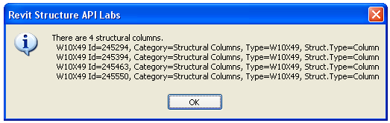
Lab – 列出所有结构柱
FamilyInstances
OST_StructuralColumns
// Get all Structural COLUMNS - we can use a generic utility.
BuiltInCategory bicSc = BuiltInCategory.OST_StructuralColumns;
FilteredElementCollector collector = new FilteredElementCollector(doc);
IList<Element> columns = collector.OfCategory(bicSc).OfClass(typeof(FamilyInstance)).ToElements();

Slide 19
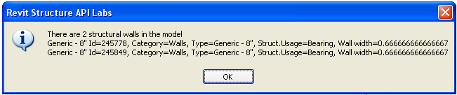
Lab – 列举出所有结构承重墙
检查 StructuralUsage 是否是 StructuralWallUsage.Bearing
IList<Element> listWalls = RstUtils.GetElementOfClass( doc, typeof( Wall ) );
//Above listWalls includes structural wall and architecture wall.
//Filter out architecture wall by Wall.StructuralUsage property.
List<Wall> walls = new List<Wall>();
foreach( Wall wall in listWalls )
{
//
// StructuralUsage has better performance than GetAnalyticalModel method.
if( StructuralWallUsage.NonBearing != wall.StructuralUsage )
{
walls.Add( wall );
}
}

Slide 20
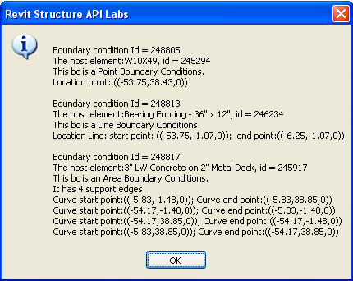
Lab – 列举出所有约束条件
listBCs = RstUtils.GetElementOfClass(doc, typeof(BoundaryConditions));
string sMsg = null;
foreach( BoundaryConditions bc in listBCs )
{
sMsg += "\nBoundary condition Id = " + bc.Id.IntegerValue.ToString();
sMsg += string.Format( "\nThe host element:{0}, id = {1}",
bc.HostElement.Name, bc.HostElement.Id.IntegerValue.ToString() );
Parameter param = bc.get_Parameter(BuiltInParameter.BOUNDARY_CONDITIONS_TYPE);
switch( param.AsInteger() )
{
case 0:
XYZ point = bc.Point;
…
break;
case 1:
sMsg += "\nThis bc is a Line Boundary Conditions.";
…
break;
case 2:
sMsg += "\nThis bc is an Area Boundary Conditions.";
…
break;
default:
break;
}
Notes:
Boundary conditions are analytical model elements that define the support conditions of a structural element by its surrounding environment. For example, the earth supports the foundation of a structure. These elements are used to communicate engineering assumptions about support conditions to analysis software packages. Boundary conditions are also known as supports or restraints in some analysis software packages.
There are three types of boundary conditions –
Point
Curve
Area

Slide 21
结构分析模型
Notes:
什么是结构分析模型线

Slide 22
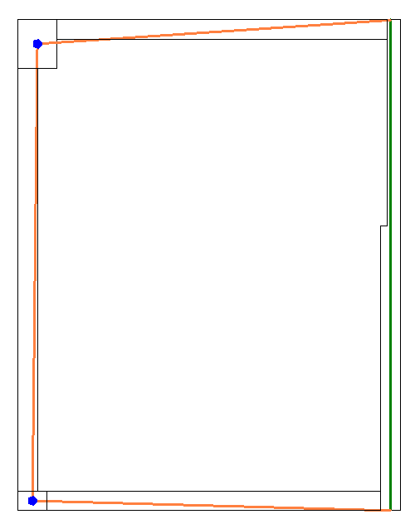
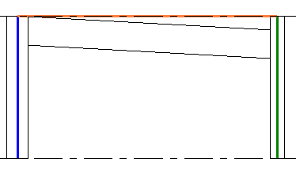
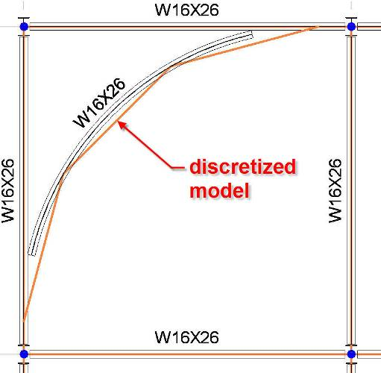
什么是结构分析模型
给结构计算工程师使用的建筑结构模型
物理模型用于绘图，协作和建造
分析模型是简化的用于计算的模型
Notes:
The most important problem of the structural industry is the fact that the information used for structural analysis is physically different than the one used for drawings. Revit Structure solves this problem. The physical model is the model that we use for drawings, coordination and construction, and the analytical model is the simplified model used for analysis.
Some examples show the discrepancies between the analytical and physical models.
For example, consider a plan view where the walls need to be aligned for the analysis and the beams need to join the centre of columns to end of walls.
Another example is an elevation where the analytical model is horizontally projected even if the physical model of the beam has a slope.
Finally, consider a situation where the physical model of the beam is curved and the analytical model is segmented.
Revit Structure maintains the coordination between the 2 models and will keep the analytical model of each element connected.
As a third party analysis developer, you just need to work with the analytical model.

Slide 23
分析模型包含的信息
需要参与到结构受力的构件
几何+物理数据
截面
材料
构件连接(铰接，固接）
楼层参考 (可选)
荷载信息
工况Load cases
荷载组合Load combinations
点荷载，线荷载，面荷载
边界条件
外界支撑
Notes:
Within the analytical model, we maintain information about all of the building members that need to be part of analysis like that of beam, columns, load bearing shear walls, foundations, etc
We also keep a track of the geometrical information like location of various elements, sections, release conditions, references levels,
We definitely need to work with loads to be able to simulate the stress on a structure, loads – point line and area
Grouping objects like combinations
Load cases etc
We also have boundary conditions and provide support information.

Slide 24
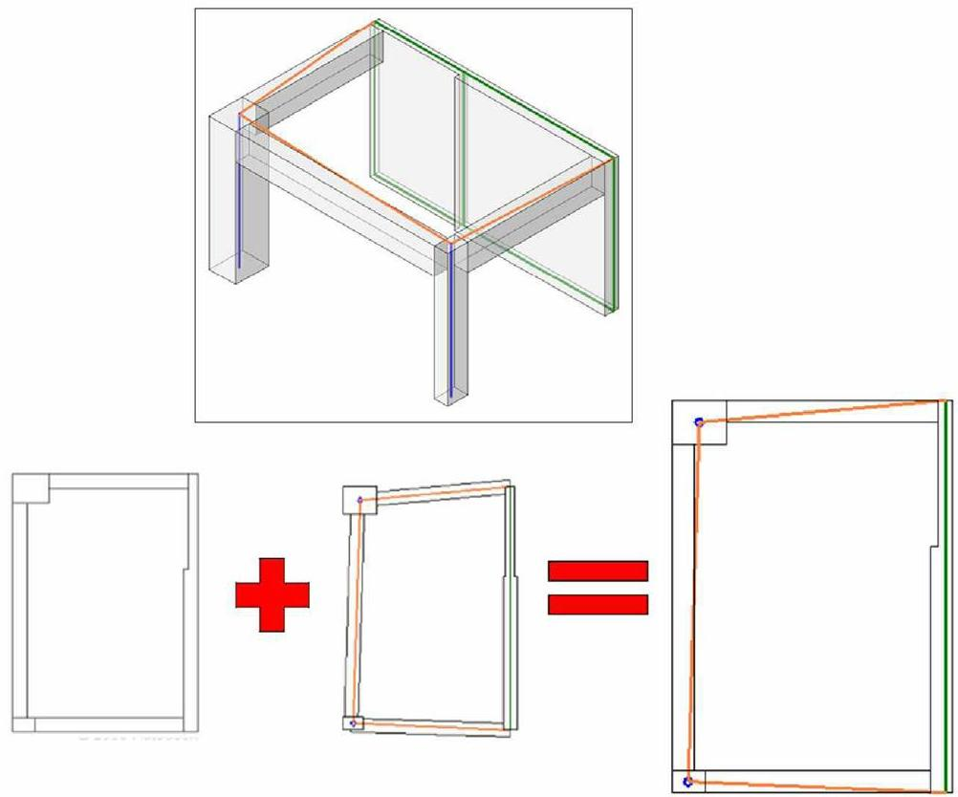
分析模型 VS 物理模型
Notes:
Revit Structure combines the physical model which drives the modeling and documentation process with the analytical model which drives the analysis process and export to third party analysis software.
The Revit Structure analytical model can be adjusted for analysis purposes while the physical model stays accurate for documentation.

Slide 25
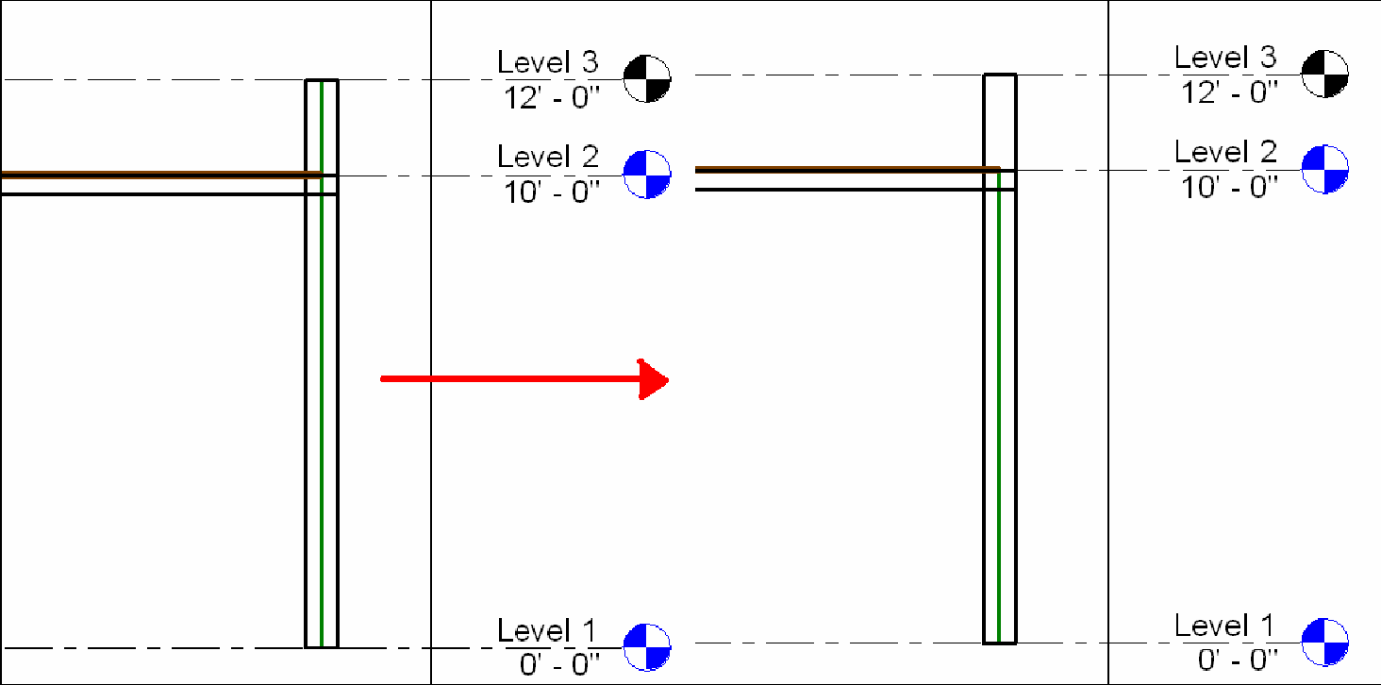
分析模型 VS 物理模型
Notes:
Here are examples of different cases highlighting the difference between the physical and the analytical models and the need for flexibility in linking the two:
The end points of two beams may are not at the same location. We want to the end points of their analytical models to be located at the same point. An engineer decides to move the end of one beam.
Remodelling an old historic building, walls may not be straight. An engineer decides to approximate them by planes for analysis.
Two walls with different thicknesses but aligned analytical planes.
A wall with a parapet that does not need to be included in the analysis.
Adjusting the location of analytical columns horizontally.

Slide 26
Data Exchange Workflow
Geometry
Physical
Analytical
Loads
Connectivity
Material
Project parameters
Notes:
In general, we start off with a physical model. This can be used to automatically generate the analytical one. The analytical model is exported to an external analysis package, which adds its own data. As a result of the analysis, the analytical model may be modified, resulting in changes in the physical model as well. New changes may be added in the physical model as well. All of these processes may continue over many iterations.
The example presented displays the following steps:
RST defines the physical model, analytical model composed of geometry, loads, connectivity (release and boundary conditions), material properties, project parameters. This is information is accessible via the API
In the analysis software we get the analytical model
Analytical model initializes specific properties not present in RST (here they are symbolized with X and Y) and the user can change them. We can do an analysis, delete specific members, change sections and then the analysis software updates the RST model
Changes can be add, delete, create, and move members and also add new properties to RST members
If we select a column and duplicate it, it will have the Y parameter that was defined in 3)
So the next time we round trip the data to the 3rd party, we retrieve the Y parameter.

Slide 27
Lab – 访问分析模型线
GetAnalyticalModel 是主要方法
所获取的分析模型线包含如下信息
位置, 参数信息 (projection, hard points, approximation, rigid links), 支撑信息 and 位置调整信息 (manual and automatic)
//Get the analytical model of the beam.
AnalyticalModel model = beam.GetAnalyticalModel();
//Get the analytical curve for column.
if( model.IsSingleCurve() )
{
Curve colCurve = model.GetCurve();
sMsg += "\n The structural beam's analytical model curve “
+ RstUtils.ListCurve( ref colCurve );
}
//get the approximated property
if( model.IsApproximated() )
{ sMsg += "\n The analytical model of this beam is approximated"; }
else { sMsg += "\n The analytical model of this beam is non-approximated"; }
Notes:
Location: Depending on the type of element, the location of the element with respect to analysis can be obtained by GetPoint() or GetCurve() or GetCurves().

Slide 28
Lab – 访问支撑信息
Access Support information from analytical model (line)
IList<AnalyticalModelSupport> supports = model.GetAnalyticalModelSupports();
sMsg = string.Format( "\nThe beam has {0} support(s)", supports.Count );
foreach( AnalyticalModelSupport support in supports )
{
XYZ supportPt = support.GetPoint();
sMsg += string.Format( "\n support#{0} point:{1}; support type: {2}",
nCounter, RstUtils.PointString( supportPt ), support.GetSupportType().ToString() );
ElementId idSupporter = support.GetSupportingElement();
Element elemSupporter = doc.get_Element( idSupporter );
sMsg += string.Format( "\n support#{0} is provided by a(n) {1}",
nCounter, elemSupporter.Category.Name.ToString() );
sMsg += string.Format( "\n support#{0}'s support priority is ",
nCounter, support.GetPriority().ToString() );
}

Slide 29
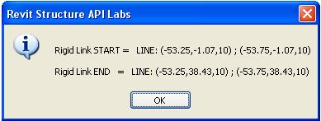
Lab – 访问刚域曲线
Display the rigid link curve of a selected beam
AnalyticalModel model = beam.GetAnalyticalModel();
if( model.CanHaveRigidLinks() )
{
sMsg += "\r\nRigid Link START = ";
AnalyticalModelSelector selector = new AnalyticalModelSelector( AnalyticalCurveSelector.StartPoint );
Curve rigidLinkStart = model.GetRigidLink( selector );
if( null == rigidLinkStart )
{ sMsg += "None\r\n"; }
else
{ sMsg += RstUtils.ListCurve( ref rigidLinkStart ); }
sMsg += "\r\nRigid Link END = ";
selector = new AnalyticalModelSelector( AnalyticalCurveSelector.EndPoint );
Curve rigidLinkEnd = model.GetRigidLink( selector );
if( null == rigidLinkEnd )
{ sMsg += "None\r\n"; }
else
{ sMsg += RstUtils.ListCurve( ref rigidLinkEnd ); }
RstUtils.InfoMsg( sMsg );
}
Notes:
The curves do not have any reference properties set and so we have to use AnalyticalModelSelector object containing the necessary information like references to curves and their end points.
A Rigid link connects the analytical model of a beam to that of a column. Use of CanHaveRigidLinks can be used to determine whether rigid links are applicable to analytical model.

Slide 30
Lab – 编辑分析模型线
Change projection and offset column’s analytical model
model = column.GetAnalyticalModel();
//Some structural component's analytical model can be offset, for instance,
// column but some cannot for example, beam.
if( model.CanSetAnalyticalOffset() )
{
//move the analytical model 3 feet along with X axis.
model.SetAnalyticalOffset( new XYZ( 3, 0, 0 ) );
}
doc.Regenerate();
//Change the projection type
model.SetAnalyticalProjectionType( AnalyticalDirection.VerticalTop, AnalyticalProjectionType.Top );
doc.Regenerate();

Slide 31
程序演示： 结构分析 Link

Slide 32
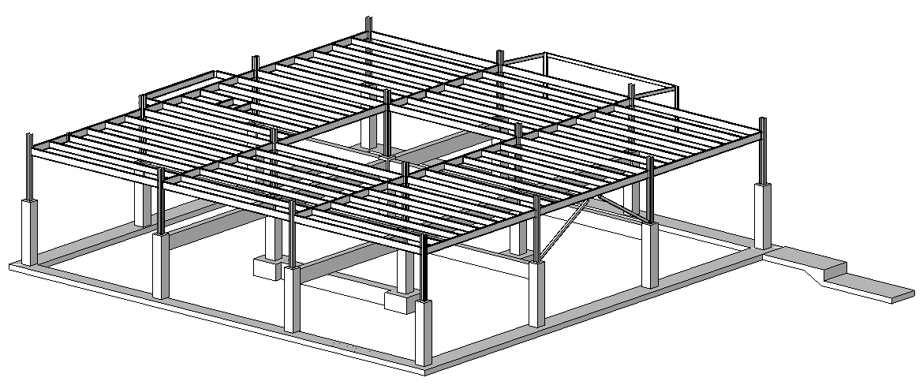
Structural Analysis Link
Introduction
Export and import
Practical examples
Sample application
Notes:
We shall discuss
the aim of this link
how to export and import data
Look at practical examples both commercial and non-commercial

Slide 33
Analysis Link 介绍
有很多种方式来设计这个link
多种应用场景考虑
哪些结构构件在两个程序间传递
哪种模型的修改会在任一个程序中都支持
第三方决定文件格式以及读写代码
Revit Structure API 提供Rvt读写接口从第三方文件读写结构信息
RST 没有预先设计读写程序
Notes:
In RST, analytical model is updated automatically as one creates or generates the physical model. The analytical model is linked to the structural analysis applications and the physical model is automatically updated from the results through the RST API.
There are many different implementation scenarios in which it might be useful to link a Revit building model with some external data, both RST-specific for analysis as we are discussing here, and also generic for other situations. Obviously, there are also many ways in which such a link can be designed.
For the RST analysis link, we need to decide which structural elements are passed between the applications and what kind of model changes are automatically supported in either of them.
It is obviously up to the individual third party package and its implementer to design, code and document the link. The Revit Structure API provides the required tools to do this, and does not pre-determine the design of the link application in any way.
They key to linking RST with other analysis applications is to set up the mapping relationship between the objects in different object models. That means the difficulty and level of integration depends on the similarity between the two object models.

Slide 34
Analysis Link 导出
从Revit导出数据到第三方计算分析程序
使用Revit的二次开发命令导出相关数据
写入数据到中间文件中
使用中间文件格式...
Notes:
For data export from Revit to a third party A&D application, one will generally use a custom Revit external command to export relevant data. The format used for this communication is once again completely up to the implementer, and could be any one of the following.

Slide 35
Analysis Link 导入
开发另一个命令
根据中间文件格式，读取其中的结构信息
Notes:
For importing the updated and modified data from the external application back into Revit, one would generally define another custom Revit external command. The choice of options and reasoning is basically the same as for the export. The chosen file format does not need to be the same as for the export, though typically it would be.
For importing the updated and modified data from the external application back into Revit, one would generally define another custom Revit external command. The choice of options and reasoning is basically the same as for the export. The chosen file format does not need to be the same as for the export, though typically it would be.

Slide 36
Analysis Link 实践例子
RstLink
简单的演示程序
MidasLink
简单，但是真实
FireRating
与Excel 读入读出防火等级数据
RDBLink
与数据库交换数据
很多的商业应用程序

Slide 37
Analysis Link Practical Example
AutoCAD 2012 simulates A&D 3rd party app
AutoCAD.NET API utilities used on the 'other' side
Xdata used to store Revit Structure specific info on standard AutoCAD entities
AutoCAD Dynamic Properties COM API used for the link-specific UI within AutoCAD
Intermediate, purpose designed XML
Used in both directions
For simplicity, based on .NET SOAP serialization
Custom .NET neutral classes utilized by both sides' export/import commands
Notes:
We have implemented a custom designed practical example of a Revit Structure analysis link application called RstLink to accompany this presentation. We use AutoCAD 2011 with an AutoCAD.NET plug-in to simulate the external third party analysis and design application and extended entity data, also known as xdata, to store Revit Structure specific information on standard AutoCAD entities. We use the AutoCAD Dynamic Properties COM API and the Object Property Manager OPM for the link-specific user interface within AutoCAD.
AutoCAD.NET API utilities used on the 'other' side
Xdata used to store Revit Structure specific info on standard AutoCAD entities
AutoCAD Dynamic Properties COM API used for the link-specific UI within AutoCAD
The data exchange in both directions between the Revit model and the A&D simulation in AutoCAD is implemented using an intermediate, custom designed XML format. For simplicity, the XML format is based on .NET SOAP serialization. Some neutral custom .NET classes are utilised by both sides' export and import commands.
Used in both directions
For simplicity, based on .NET SOAP serialization
Custom .NET neutral classes utilized by both sides' export/import commands
Before running the demo, the following applications need to be present:
RstLink - helper dll shared by both acad and revit client
RSLinkRevitClient - command implementations
RSLinkRevitApp - external application
RSLinkAcadClient - AutoCAD client
RSLinkAcadClientDynProps - dynamic Revit properties for AutoCAD objects
Here are possible steps to run the demo:
Set up Revit.ini to load either the client or the external application or both.
Open or create a sample model in Revit Structure.
Run the export command. You are prompted for a file location. A dialogue box pops up, reporting the number of exported elements.
Start up AutoCAD and load the client and the dynamic property application.
This can be achieved automatically by setting up AutoCAD to start in the RVT sample directory and placing an acad.lsp file there containing:
(defun s::startup()
(command "_netload" "RSLinkAcadClient.dll")
(princ "\nAutoCAD RSLink client loaded.")
(arxload "RSLinkAcadClientDynProps.arx")
(princ "\nAutoCAD RSLink dynamic properties loaded.")
(princ)
)
If it does not load automatically, you can load it manually by calling
(load "C:/a/j/adn/revit/rst_api/RVT/acad.lsp")
with the appropriate full path, and then call
(s::startup).
The commands defined by the AutoCAD client are RSImport, RSExport and RSMakeMember.
Use RSImport to load the xml file just exported from Revit.
Modify some cross sections in the model using the OPM, simulating modifications made by the A&D application, and optionally RSMakeMember to add some new elements.
Use RSExport to write the model back out again.
Back in Revit, use the import command to read the modifications and update the Revit model accordingly. Dialogue boxes are displayed to report the number of elements imported and modified. Note that the column types were swapped. Currently, the new elements defined by RsMakeMember are ignored.

Slide 38
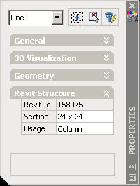
Analysis Link RstLink modules
RstLink
Helper dll shared by both acad and revit client
RSLinkRevitClient
Revit command implementations
RSLinkImport, RSLinkExport, RsLinkLiveLink
RSLinkAcadClient
AutoCAD client
RSImport, RSExport, RSMakeMember
RSLinkAcadClientDynProps
Dynamic Revit properties for AutoCAD objects
Notes:
RSTLink is the helper or shared module that is shared between both ACAD and Revit.
RSLinkRevitClient implements external commands for use inside of Revit
AutoCAD client handles Xdata and
ACAD client dynamic properties module to handle dynamic properties.

Slide 39
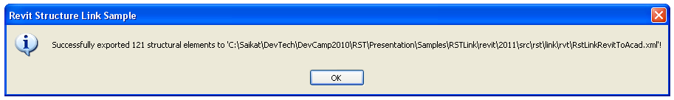
Analysis Link RstLink Revit Export

Slide 40
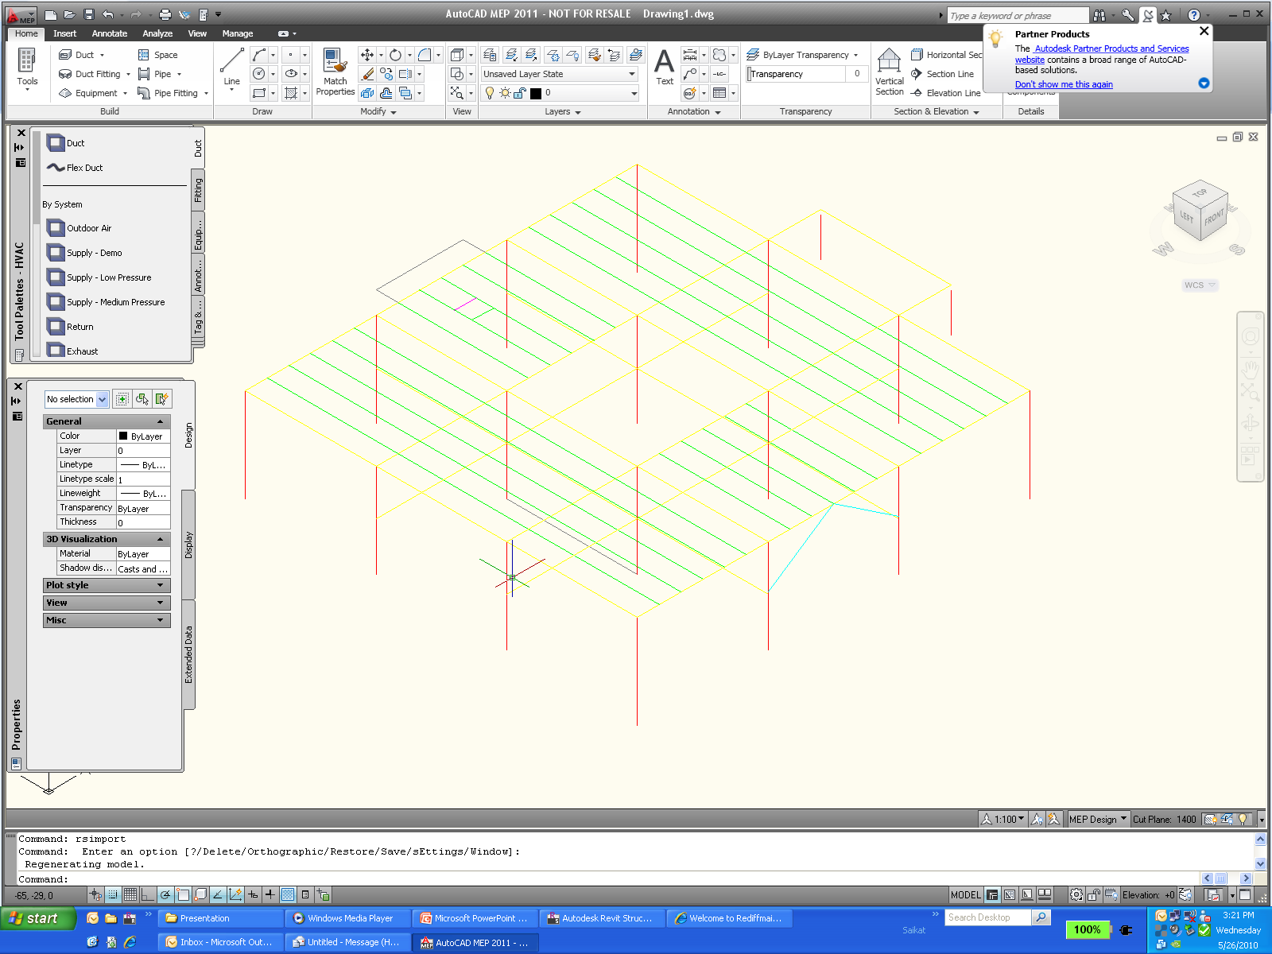
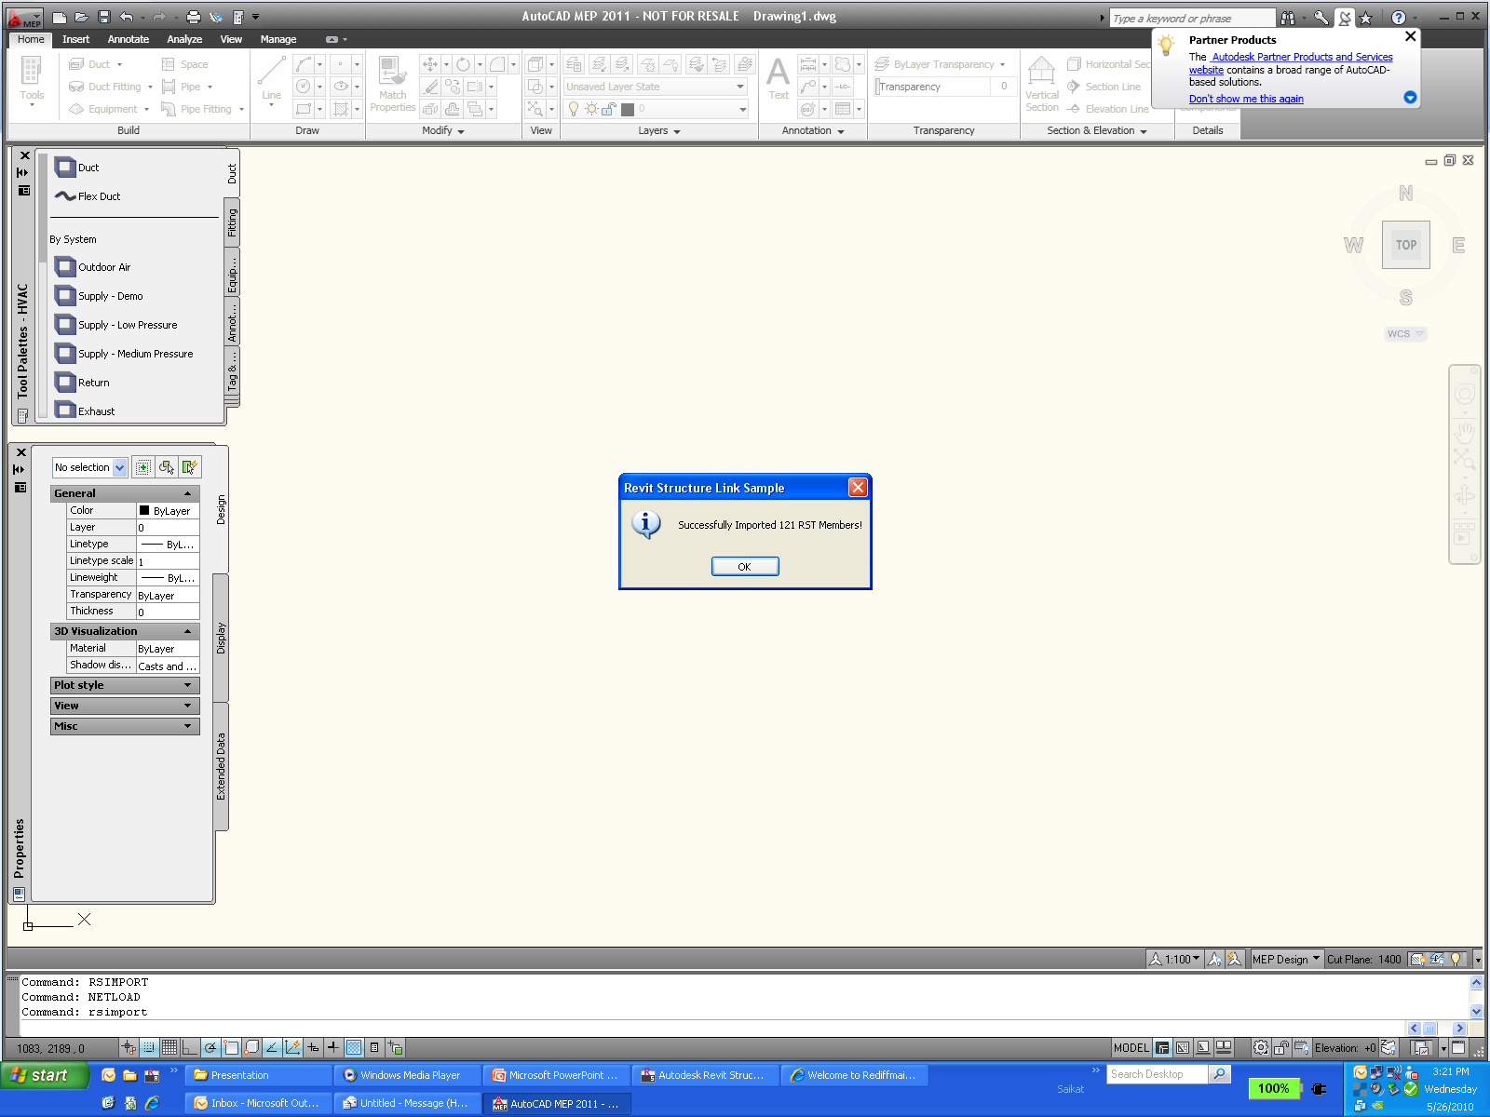
Analysis Link RstLink AutoCAD Import
Notes:
Invoke RSImport command

Slide 41
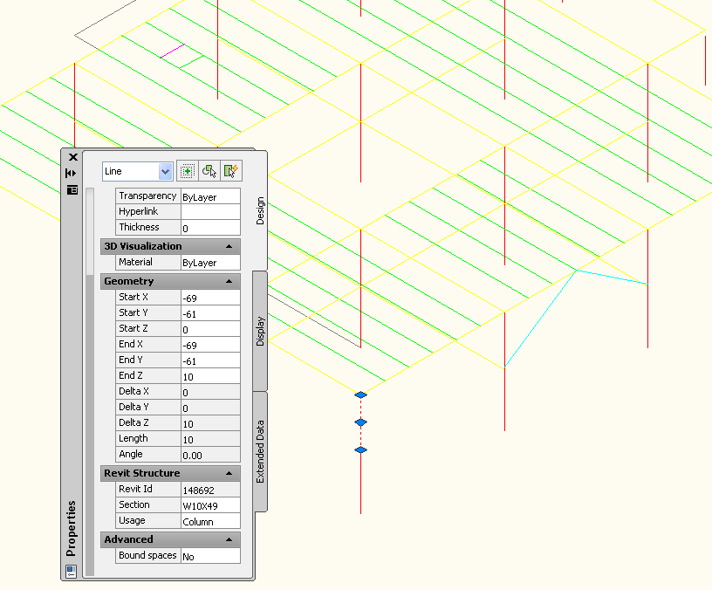
Analysis Link Modify Cross Section
Edit dynamic properties
Change cross section

Slide 42
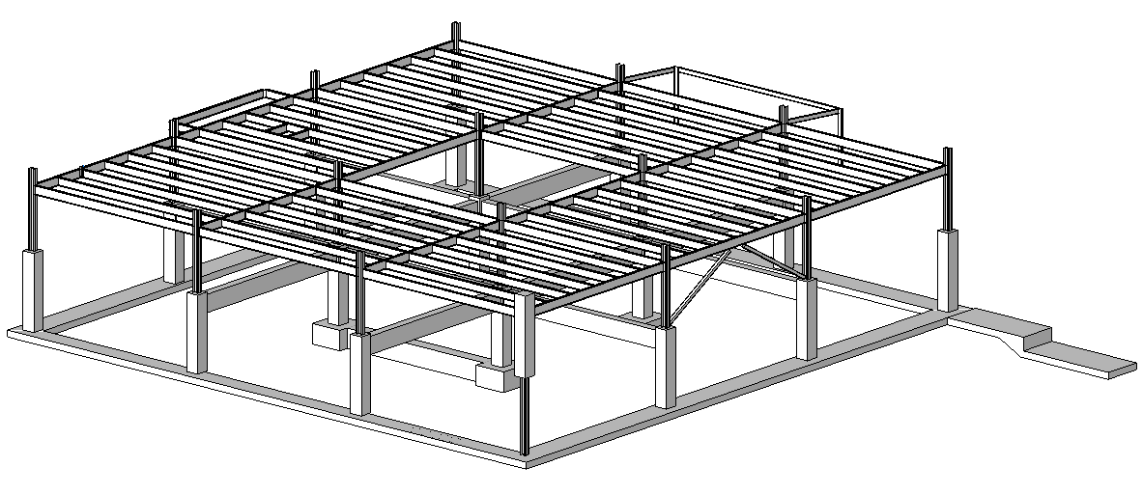
Analysis Link Import Modified Data Into RST
RSExport from AutoCAD
Import into Revit
Column type was swapped
New elements are ignored

Slide 43
Analysis Link 结构计算软件
ADAPT
www.adaptsoft.com/revitstructure
RISA
www.risatech.com/partner/revit_structure.asp
RAM
www.bentley.com/structural
CSC
MIDAS – MidasLink subscription module
ROBOBAT – recently acquired by Autodesk
http://www.extensions4revit.com/n/e4r
Analysis Partners site:
http://usa.autodesk.com/adsk/servlet/index?siteID=123112&id=9727285#content2
Notes:
Some third party software developers already provide bi-directional links to their structural analysis applications. The list is included in this slide.
Source code for Midas Link 2009 can be obtained from ADN extranet.

Slide 44
Rebar

Slide 45
RST 配筋 Workflow
Revit Structure 3D
Object Model
User
Input
3rd Party
Analysis
Design
Physical Model
Analytical Model
User
Input
3D Rebar Model
Concrete Drawings
User
Input
Typical Rebar Details
Specific Rebar Details
Specific Rebar Details
3D Design
QTO
Shop
Drawing
Manual
Automated
Notes:
Working with reinforcements in Revit Structure involves two phases. The initial phase is the building analysis, which may result in design changes. In the second phase, reinforcements are added, analysed, and detailed. Both phases may include multiple iterations. Many of the tasks required can be automated. This is where our applications can save a lot of time, effort, and eliminate sources for errors.
The central hub is the Revit Structure three-dimensional object model which integrates the physical and analytical models used respectively for the building design and analysis. The 3D rebar model is integrated in this database. The physical model is used to generate concrete drawings including rebar specific details. The rebar model can be used to generate rebar specific details and quantity takeoffs. The analytical model is used to connect to third party analysis and design packages, which in turn can help define the rebar model.
The typical workflow in RST with rebar design starts with user inputs, which creates a physical model, which is automatically synchronized with that of the analytical model. At this stage, we can use 3rd party analysis design applications to design and the results of these analysis design can be fed back to the model. Once the physical model has been updated, we can generate updated concrete drawings. At this stage, we can get additional user inputs to design the rebar details. This will result in generating a 3D rebar model and this information can extract the specific rebar details, QTO and finally create shop drawings.

Slide 46
3D钢筋模型
Revit Structure 的3D钢筋模型包含这些对象：
单一钢筋
箍筋
面积钢筋（板和墙）
路径钢筋（板）
3D 钢筋模型可以被如下方式生成
用户手动
API 开发的程序
3D钢筋的优势
数量
复杂的布局
自动绘制钢筋图
基本钢筋表
钢筋表各国不太一样
是二次开发的机会
Notes:
RST defines 3D rebar model. Composed of Single bars, Sets which are arrays of bars with set of rules, area reinforcement bars and path reinforcement for slabs.

Slide 47
梁或柱配筋
类
Autodesk.Revit.Elements.Rebar
代表钢筋用来加强构件，如混凝土梁，柱，板，基础
设置钢筋布局：
0 – None; 1 – Fixed Number; 2 – Maximum Spacing;
3 – Number with Spacing; 4 – Minimum Clear Spacing;
Rebar r = doc.Create.NewRebar( rebarStyle, rebarType, startHook, endHook, hostObject, normal, curves, startRebarHookOrientation, endRebarHookOrientation, booleanUseExistingShapeIfPossible, boolCreateNewShape );
Rebar r = doc.Create.NewRebar(RebarShape, RebarBarType, host, origin, xVec, yVec);
Parameter paramLayout = rebar.get_Parameter(BuiltInParameter.REBAR_ELEM_LAYOUT_RULE);
paramLayout.Set(1);
Notes:
Three kinds of beam rebar are created: top, bottom and transverse rebar. Two kinds of column rebar are created: transverse and vertical. Autodesk.Revit.Creation.Document.NewRebar() method can be used to create rebar for the selected host. There are two overloads of the NewRebar() method both of which is listed in the slide.
The first version creates a rebar from an array of curves describing the rebar. The second version created rebar object based on a rebar shape and position.

Slide 48
创建楼板和墙钢筋
XYZ p1, p2; Line curve;
CurveArray curves = m_appCreator.NewCurveArray();
for( int i = 0; i < points.Count - 1; ++i )
{
p1 = new XYZ( points[i].X, points[i].Y, points[i].Z );
p2 = new XYZ( points[i + 1].X, points[i + 1].Y, points[i + 1].Z );
curve = rvtDoc.CreateNewLine( ref p1, ref p2, true );
curves.Append( curve );
}
return rvtDoc.Create.NewPathReinforcement( m_host, curves, boolFlip );
Notes:
The PathReinforcement host is a floor or a wall. The method used is
NewPathReinforcement(Element, CurveArray, bool );
We can use Document.Create.NewPathReinforcementType() method to create a PathReinforcementType if there is none in current document. The Element argument is the host of the PathReinforcement. The CurveArray stores its path. The Boolean value indicates which side of the path the PathReinforcement is located on.

Slide 49
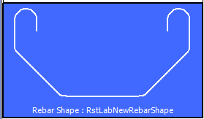
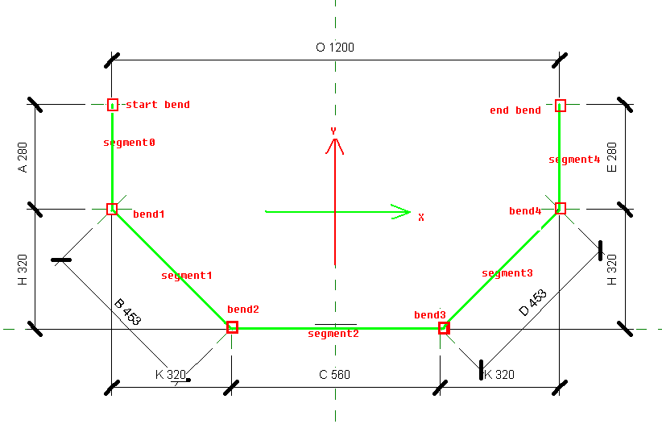
Lab – 创建钢筋形状
RebarShapeDefinitionBySegments
先创建钢筋的分段管理对象 RebarShapeDefinitionBySegments
创建每一段，指定默认长度
给每一段约束信息，设置每一段的方向，两段之间的角度（锐角，直角，钝角） myDef.AddConstraintToSegment myDef.AddConstraintParallelToSegment myDef.AddBendDefaultRadius myDef.SetSegmentFixedDirection myDef.AddListingDimentionBendToBend
使用已经定义好的分段信息，创建钢筋样式 RebarShape.Create
检查默认参数值是否能定义出这个样式

Slide 50
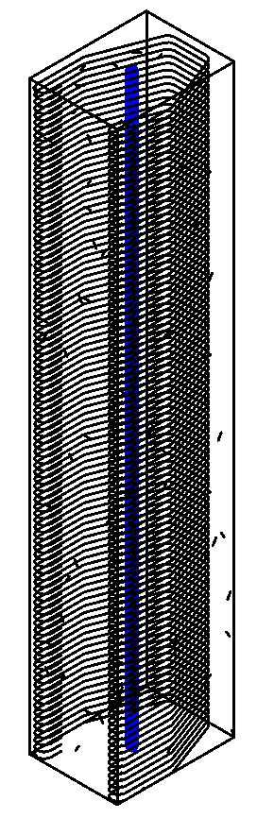
Lab – 给柱子配箍筋
用前面创建的钢筋类型给柱子配筋
1. 获取刚才定义的样式（根据样式名称）
2. 获取钢筋的直径
3. 从柱子读取柱子的截面，截面中心点，柱子的方向线
4. 根据这些数据创建钢筋
5. 把箍筋与柱子界面匹配
6.设置钢筋间距

Slide 51
Revit 平台 API 在RST中的应用
Dynamic Model Update, Analysis Visualization Framework, Idling Event

Slide 52
动态模型更新
当Revit中的对象发生改变时，二次开发程序借此机会对模型进行修改。
同属一个事务，undo，redo自动同步
Notes:
Dynamic model update offers the ability for a Revit API application to modify the Revit model as a reaction to changes happening in the model. Application.DocumentChanged event is read-only event and thus it does not support modification to Revit database. For that, we can use the DMU mechanism.
With this mechanism, Revit will now let you know when elements are added, modified or deleted.
The ability to track and modify the model as a reaction to changes in the model, is offered through implementation of updaters. The updater interface offers the ability to implement a method that is informed of the scope of changes that triggered the changes.
Updaters are classes which implement IUpdater interface. So as our next step, we shall create Updater class and implement the IUpdater interace in it. This interface implementation includes some methods like -
GetUpdaterId – This method returns the unique id of the updater which includes the application Id and a GUID for this updater. This is used when Revit remembers the details about the updater which drives a set of elements in the document and is called once during the registration of the Updater.
GetUpdaterName – This method returns the name by which the updater can be identified by the user, in case there is any problem with the Updater at runtime.
GetAdditionalInformation – This method returns the auxiliary strings which are displayed in situations when the updater (that was used to drive the document) is not present or not loaded.
GetChangePriority – This method identifies the nature of the changes the Updater will be performing. It is used to identify the order of execution of updaters and called once during the registration of the Updater.
And Execute – this method is updated of the scope of the changes that triggered the update and allows API users to make changes of its own to the elements in the document.
The next step is to register the Updater class in the onStartUp method of the external application. We create a new instance of the Updater class. Using the application level singleton UpdaterRegistry class which stores all the registered Updaters, we can use its RegistryUpdater() method to register the Updater object.
The process of subscribing an Updater is done using update triggers. Update triggers are combination of “Change Scope” and “Change Type”. Change Scope may either be an explicit list of element Ids or an implicit list of elements communicated via the ElementFilter. Change Type represents one of possible changes including element addition, deletion and modification of geometry, parameters or any property of the element.

Slide 53
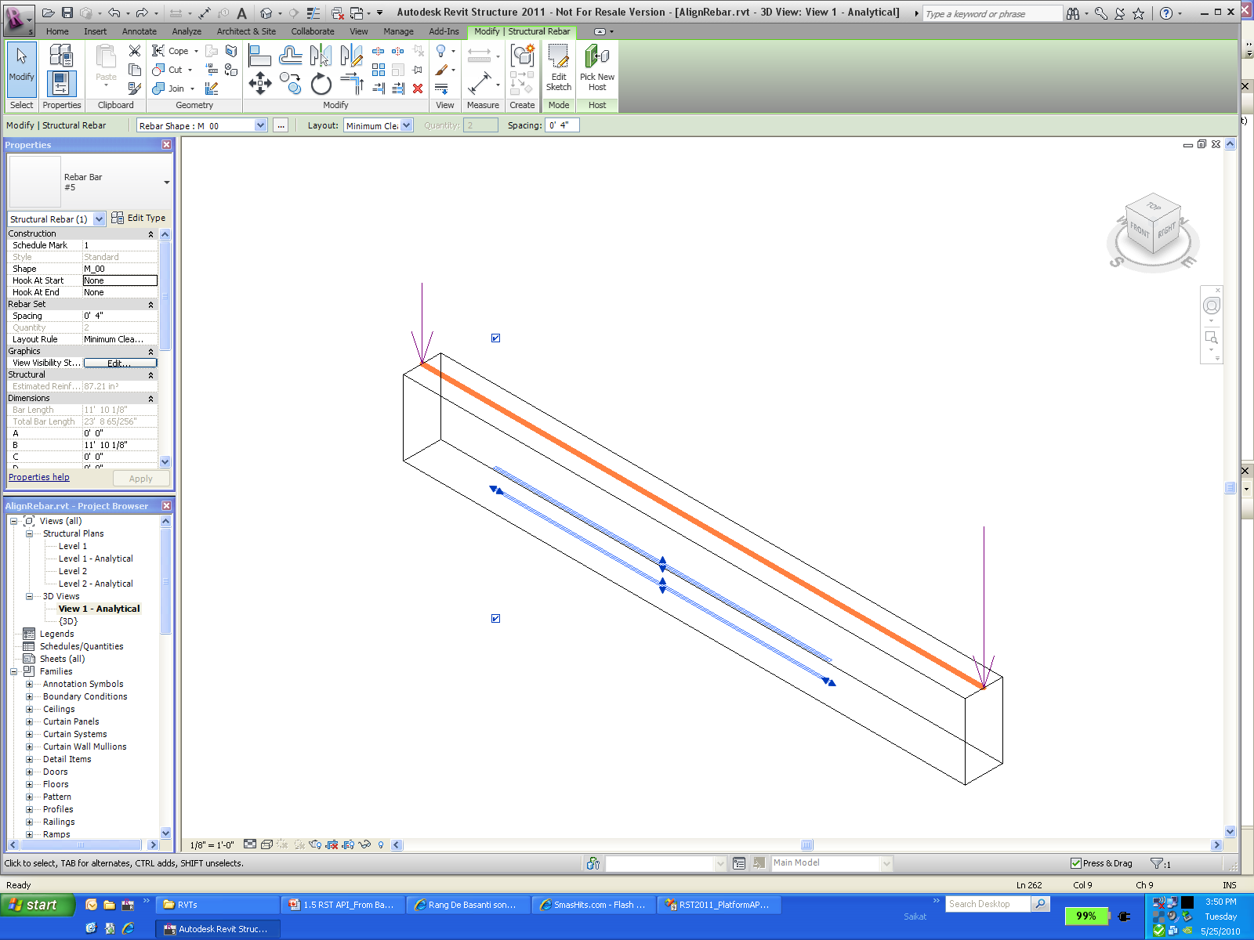
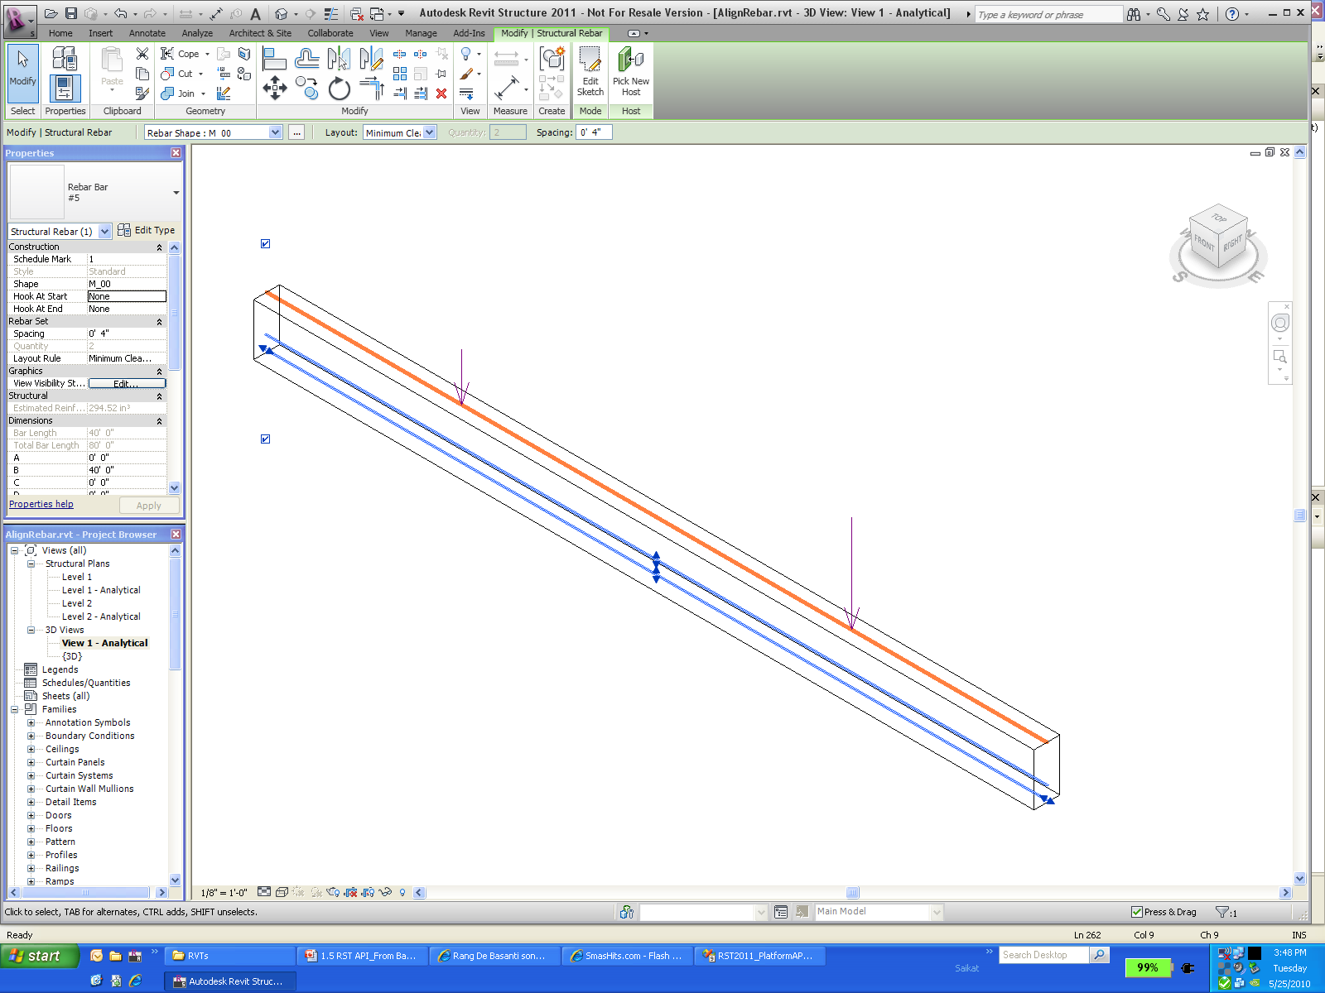
Lab – Revit结构中的动态模型更新

Slide 54
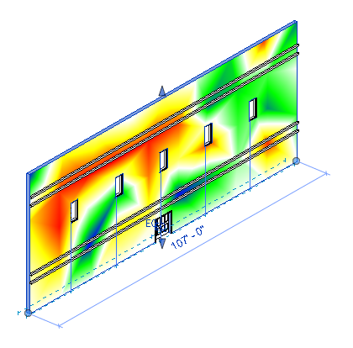
分析可视化框架
在模型中用云图显示各种分析结果
可以控制显示样式和图例样式
暂时显示，不能保存在模型中
Primary APIs
SpatialFieldManager class
FieldDomainPoints class
FieldValues class
AddSpatialFieldPrimitive method
UpdateSpatialFieldPrimitive method
AnalysisDisplayStyle class
Notes:
This new functionality creates a mechanism for external analysis applications to easily display the results of their computation as 3D data in the Revit model. Note that the results data is transient; it is stored only in the model for the duration of the current Revit session. This feature is designed to allow third party applications to deeply integrate into Revit, do the calculations in their own third party applications, and then create this framework for displaying the results of the computations inside the Revit model. The analysis colors are based on certain values applied based on U and V points on the surface. And a new analysis display style will be used to decide on the display colors, marker types, legend style, text on surface, etc.
The SpatialFieldManager class is used to create, delete, and modify the "containers" in which the analysis results are stored.
The FieldDomainPoints sub-classes indicate the points where analysis results are computed.
The FieldValues class contains the values for each domain point. Each domain point can have multiple values, each for a separate "measurement" at this point. For example, if a solar calculation is being done for every day of the year, each point would have 365 corresponding values

Slide 55
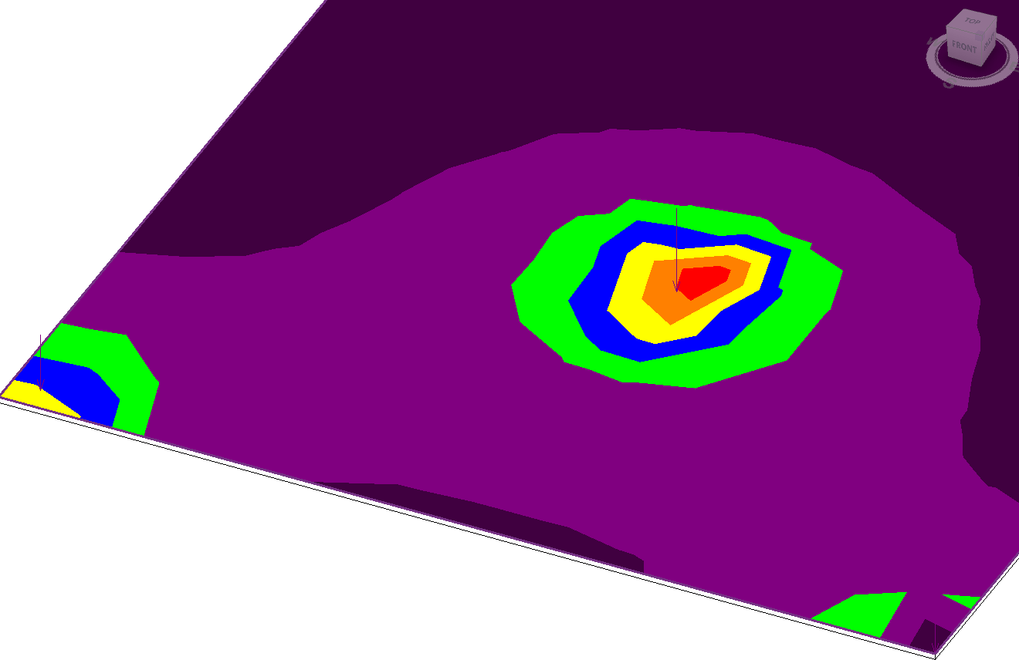
Lab – 演示

Slide 56
结束总结

Slide 57
深入学习
SDK中的资源
Revit 2011 API DevTV中文
http://download.autodesk.com/media/adn/Revit_2011_API_DevTV_Chinese.zip
论坛讨论组
http://discussion.autodesk.com > Revit Architecture > Revit API
API 培训课程& DevLab
http://www.autodesk.com/apitraining
The Building Coder, Jeremy Tammik 的 Revit API 博客
http://thebuildingcoder.typepad.com
我爱Revit-二次开发专栏博客(中文）
http://blog.csdn.net/joexiongjin
加入ADN
http://www.autodesk.com/joinadn
ADN网站有大量常见问题解决方案（只有ADN用户才能访问）
http://adn.autodesk.com
Notes:
Point out that the webcast is *this* webcast. The bottom two items are for members only, the top ones are all publicly available.

Slide 58
问答互动

Slide 59

End of Presentation

